Slide 1
Metis Project 1: EDA of MTA Turnstile for WTWY
By: Team 5
Sean Davern, Scott Kroeger, Kristen Tokunaga

Slide 2
Problem
↑Sign ups
↑OMGYN Gala attendance
↑Awareness
↑$
Optimize placement of street teams
Notes:
Problem = Motivation, Objective, Goals
An email exchange with a client
Chad, Cliff and Roberto -
It was great to meet with you and chat at the event where we recently met and had a nice chat. We’d love to take some next steps to see if working together is something that would make sense for both parties.
As we mentioned, we are interested in harnessing the power of data and analytics to optimize the effectiveness of our street team work, which is a significant portion of our fundraising efforts.
WomenTechWomenYes (WTWY) has an annual gala at the beginning of the summer each year. As we are new and inclusive organization, we try to do double duty with the gala both to fill our event space with individuals passionate about increasing the participation of women in technology, and to concurrently build awareness and reach.
To this end we place street teams at entrances to subway stations. The street teams collect email addresses and those who sign up are sent free tickets to our gala.
Where we’d like to solicit your engagement is to use MTA subway data, which as I’m sure you know is available freely from the city, to help us optimize the placement of our street teams, such that we can gather the most signatures, ideally from those who will attend the gala and contribute to our cause.
The ball is in your court now—do you think this is something that would be feasible for your group? From there we can explore what kind of an engagement would make sense for all of us.
Best,
Karrine and Dahlia
WTWY International
Draft Proposal:
WTWY street teams
Problem statement:
WTWY needs to optimize their street teams so that they can get the most email signups for their annual OMGYN Gala. Ideally, the email signups will convert at a high rate to gala attendees, and among attendees, many will make contributions to WTWY.
MTA data obtained from the NYC Data Portal provides rich information about the travel patterns of New Yorkers -- using this information, can we create a street team deployment plan that will optimize WTWY’s resources toward achieving their goals?

Slide 3
Methods
High-Traffic Subway Entrances
Obtain: MTA Subway Data for Spring 2019
Scrub:
Entry/Exit Cumulative Values
Subway Station Locations
Explore: Entries & Exits
Notes:
Karrine & Dahlia -
Hope you are well! We pulled the mta data from the public data portal and ran some initial feasibility analyses. Check out the attached document. With the MTA data alone, we can definitely help you to find places to deploy your teams to access the most people per day. We also included a few more ideas of different scales that would greatly improve the effectiveness our analyses could have toward achieving your goals.
Let us know what you think—we can set up a call to go through this with you, maybe this Thursday or Friday after 3?

Slide 4
Methods
Tech Company Locations
Obtain: Searched addresses of 15 tech companies, identified by Forbes
Explore: Locations relative to subway stations
Notes:
1-2 Slides
Data, Models, Metrics, Tools

Slide 5
Results
Top XXX Stations by Average Daily Turnstile “Entrances” & Weekday
[Insert image]
Assumptions:
Every subway rider has an equal likelihood of attending & contributing
Weekly commuter patterns in Spring 2019 are consistent with Spring 2020
Notes:
Preliminary results:
Here are some preliminary results we found, as a taste of what we can do.
Most overall traffic:
Let’s start at the start and simply see where the most traffic is. This has a lot of assumptions baked into it, so we’ll examine these and refine our recommendations as we continue.
Top five stations in terms of average daily turnstile entrances:
34th St - Penn Station
42nd St - Grand Central Station
34th St - Herald Square
14th St - Union Sq
42nd St - Times Sq
[make a table or chart to put here instead of list]

Slide 6
Results
Map of Stations, Technology Companies, Technology Schools
Notes:
Stations: by Average Daily Turnstile “Entrances”
Technology Companies (sample of 15): by square footage
Technology Schools (NYC, CUNY [New York City College of Technology, NYIT]): by student population size
We can also break this down by day:
[chart or table broken down by day] Can we filter out the tourists?
So far, this assumes that any subway rider is equally likely to sign up for the Gala email list. Of course, this is not the case. There are a number of ways to narrow down stations to those that would maximize the number of people aligned with the ideals of WTWY, many of which would involve external data sources. But we wanted to see what we could do with the MTA data alone.
One thing we thought would be helpful would be to find stations where the number of tourists is low (people who will not be around to attend the Gala) and most riders are native New Yorkers (people who will). Stations that are used primarily for commuting will have many more native residents than those that are popular tourist locations.
We identified in the data a signature of commuter travel: stations with high and consistent usage on weekdays, and low utilization on the weekend [a]. Stations that are popular with tourists have less of a difference between weekend and weekday travel [b], or are much more chaotic and event-based [c].
[insert examples a,b,c] Combining overall ridership with commuting patterns, we can build you a prioritized list of stations that will give you the most native New Yorkers per street team unit. This can easily be broken down by day, in case there are slight differences among weekdays.

Slide 7
Conclusion
Recommendations:
Weekdays
Optimal stations
34th St - Penn Station
42nd St - Grand Central Station
34th St - Herald Square
14th St - Union Sq
42nd St - Times Sq

Slide 8
Future Work
Who are these travelers?
Where are potential contributors located?
Historical demographic data of past attendees/signups by location—if available
Tailor recommendations to WTWY resources
Hourly schedule of subway locations
Notes:
Email addresses – find where past attendees/contributors are coming from and connect with their organizations’ leadership, if applicable
What else we could do:
More fun with MTA data
For this feasibility analysis, we collapsed data to the day and station. This gives us some great information for daily scheduling. We can additionally break this data down into morning and evening ridership, or even the mid-day (lunch hour) interval.
We also noticed that the top stations have much much greater volume than other stations that are still very high up on the list. With more information about the size of your street team force and the number of workers per team, we can build a model that allows more than one team to be deployed to very-high-volume stations
[insert example or doodle]
seasonal
entrances
Adding more data sources (etc.)
Using only the MTA data, we can make some rough guesses about the people who are using the station, based on the weekly patterns of ridership. Beyond that, however, we are fairly blind. To help the WTWY achieve its conversion goals, we have a few ideas that would slightly broaden the scope of this project and result in much greater returns.
Geographic & demographic information about areas around stations
Bring on an ethnographer or marketing specialist to help us create profiles of those most likely to attend the Gala and contribute
Design some A/B tests or similar experiments to gather data informed feedback on signature conversions
On the very-large scale side of things, we could design for you an optimizer that assigns deployments and collects signature results in real time. This did not really sound like the scope of project you were interested in at the time of our conversation, but if it piques your interest we’d could tell you more. Systems like these are often flexible enough to serve multiple marketing and fundraising needs for an organization.

Slide 9
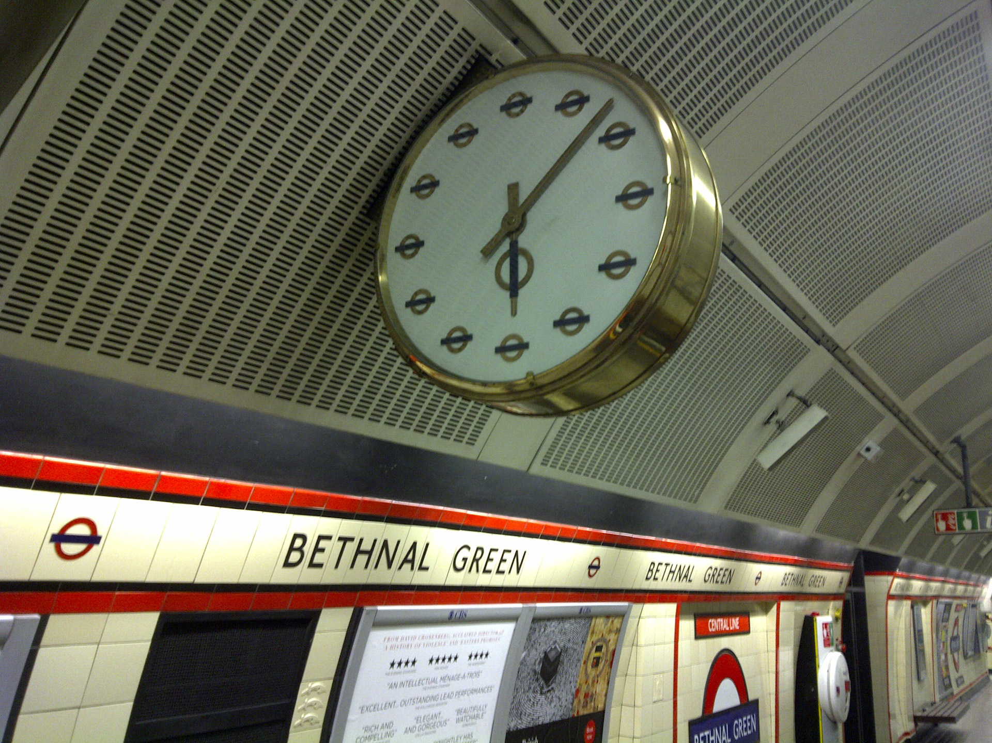
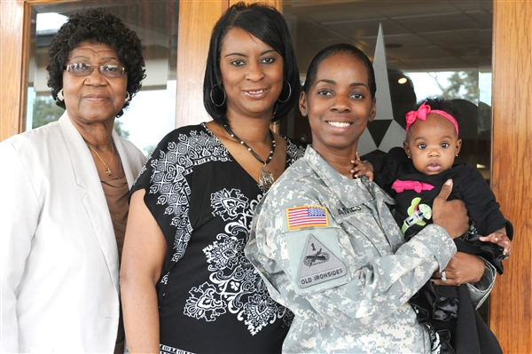



Future Work
Days / Times
Target
Specific
Areas
Demographics
Tech
Companies

Slide 10
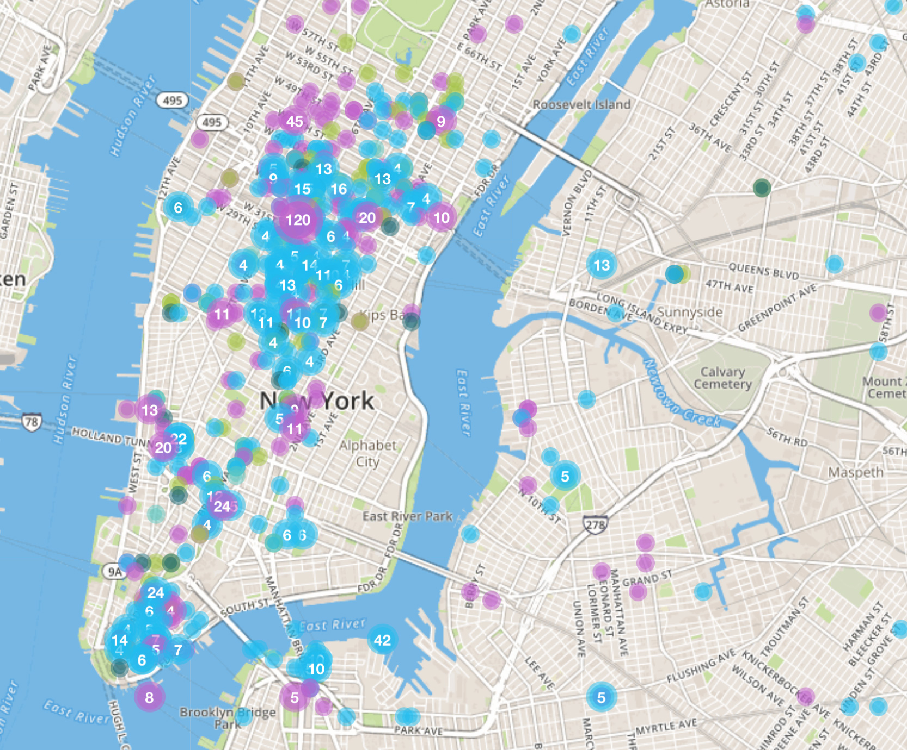
NYC Tech Scene
Digital NYC: http://www.digital.nyc/map

Slide 11
NYC Tech Scene
10001 $660 M
10011 $586 M
10010 $365 M
10007 $254 M
10016 $185 M
10018 $173 M
10036 $171 M
10013 $156 M
10012 $157 M
10014 $78 M
Built IN NYC: https://www.builtinnyc.com/2016/08/09/nyc-fundings-zipcode-2016

Slide 12
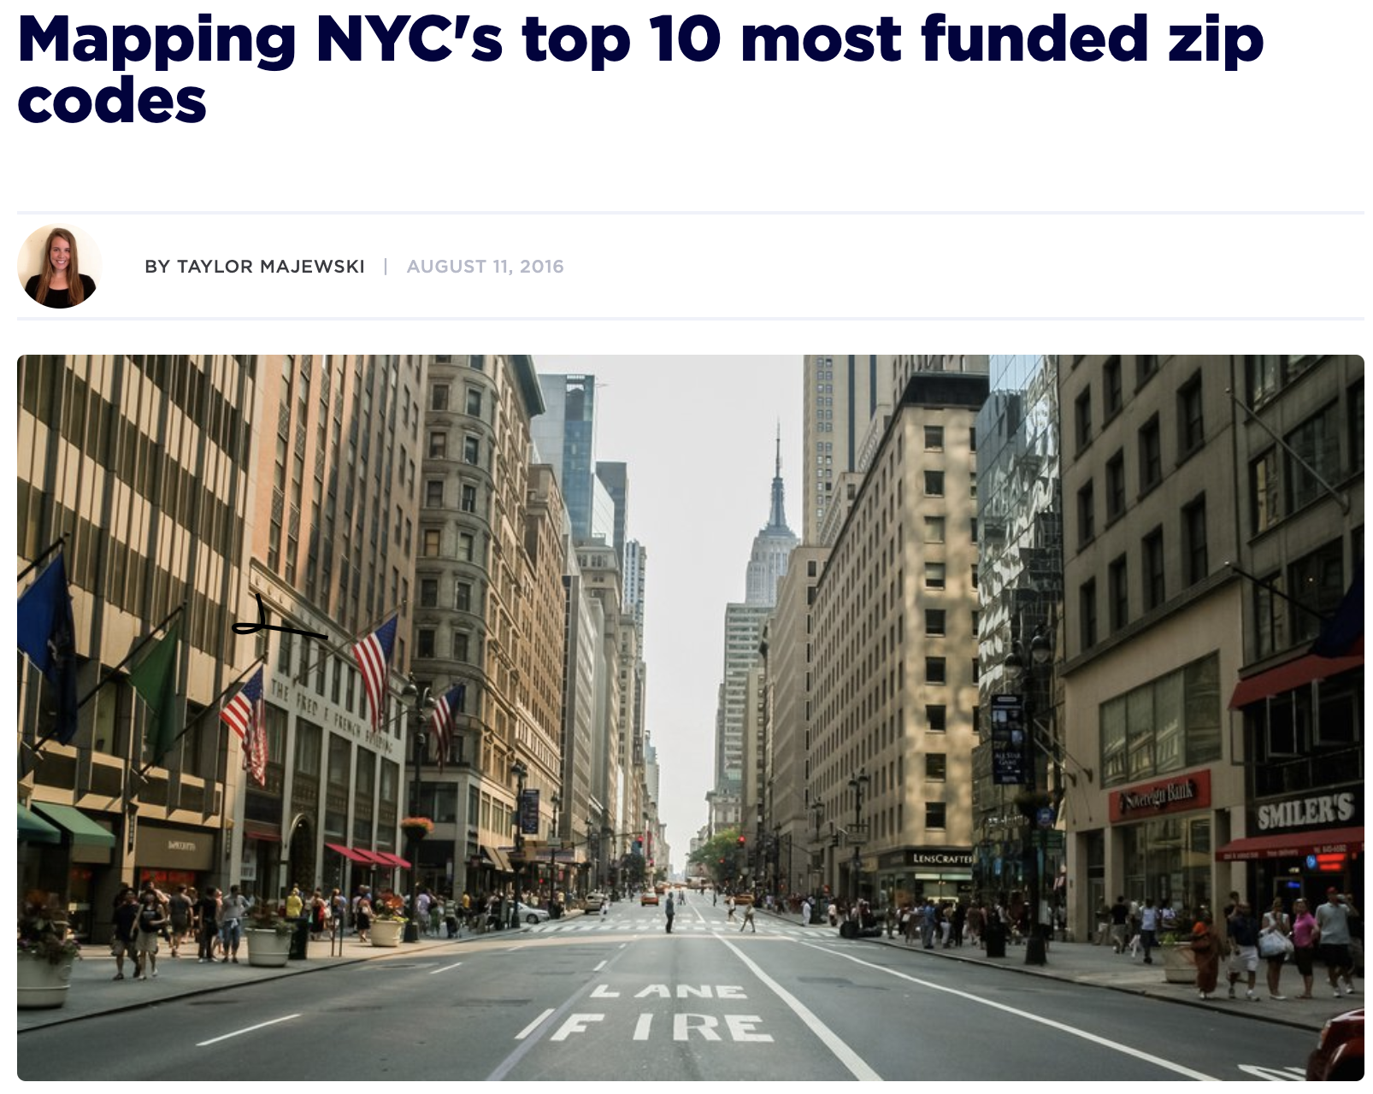
NYC Tech Scene
10001 $660 M
10011 $586 M
10010 $365 M
10007 $254 M
10016 $185 M
.
.
.
Built IN NYC: https://www.builtinnyc.com/2016/08/09/nyc-fundings-zipcode-2016

Slide 13
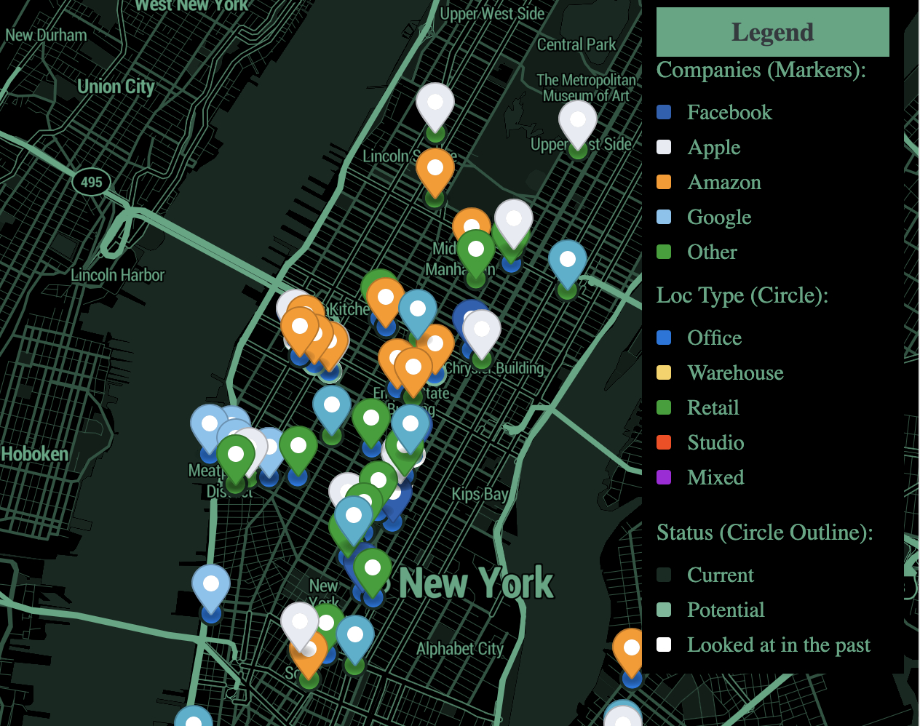
NYC Tech Scene
15% of Manhattan office space.
The Real Deal (NYC Real Estate News): https://therealdeal.com/2019/08/23/map-heres-a-look-at-all-the-big-tech-locations-in-nyc/

Slide 14
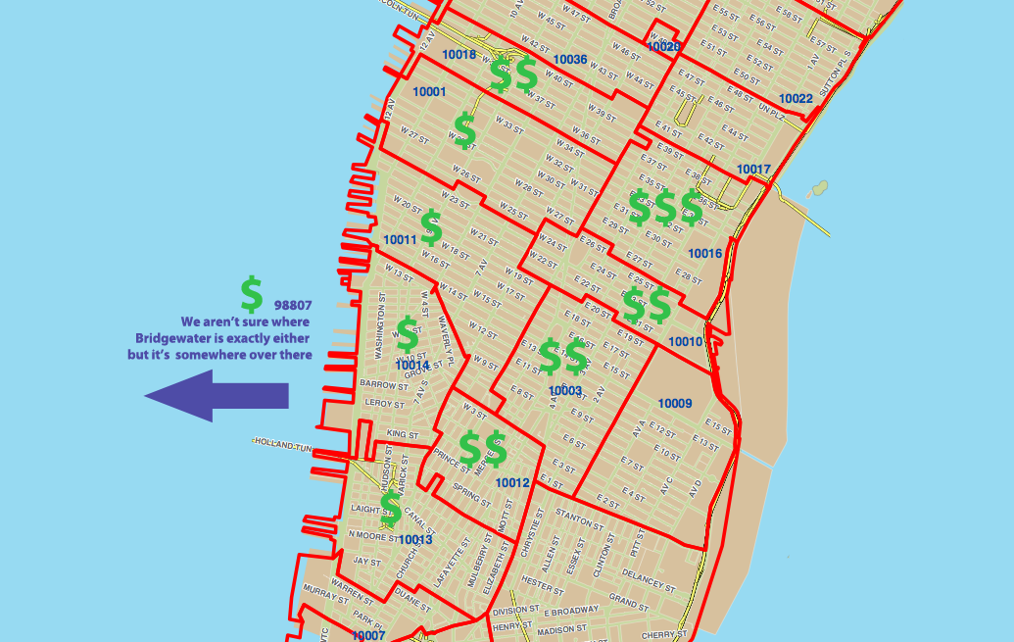
NYC Tech Scene
1. 10016
2. 10010
3. 10012
4. 10003
5. 10018
6. 10011
7. 10013
8. 10001
9. 08807
10. 10014
Alley Watch: https://www.alleywatch.com/2013/09/the-10-nyc-zip-codes-getting-the-most-vc-investment/

Slide 15
Questions?
Notes:
Conclusion:
We had a lot of fun wrangling the mta data and coming up with these simple plots. Based on your interests and scope, we can go ahead with anything discussed above, or meet to iterate on these themes. We’re really looking forward to working with you! Women in tech is an issue we love to support.

Slide 16
Appendix
Digital NYC Map of Tech Startups
https://www.digital.nyc/map
Notes:
Digital NYC Map of Tech Startups “Official Online Hub for Tech and Startups in NYC”

